Slide 1

DriverPass System Analysis
David Wasson
Notes:
[No speaker notes required for this slide.]

Slide 2

System Requirements
Two functional requirements
Customer chooses a package
Admin can update customer information
Two nonfunctional requirements
Security
Adaptability
Notes:
I chose customer choosing a package and the admin updating customer information as functional requirements. DriverPass is based on customers being able to choose a package to buy. I chose the admin updating customer information as this helps ensure a customers can access DriverPass when they need to. I chose security because DriverPass will be storing personal information of its customers. The system will need to protect this information. Customers phone numbers, addresses, and payment information must not be compromised. Adaptability is important as this allows for growth, allows for maintenance, and allows for updates to the information to keep up with the DMV.

Slide 3
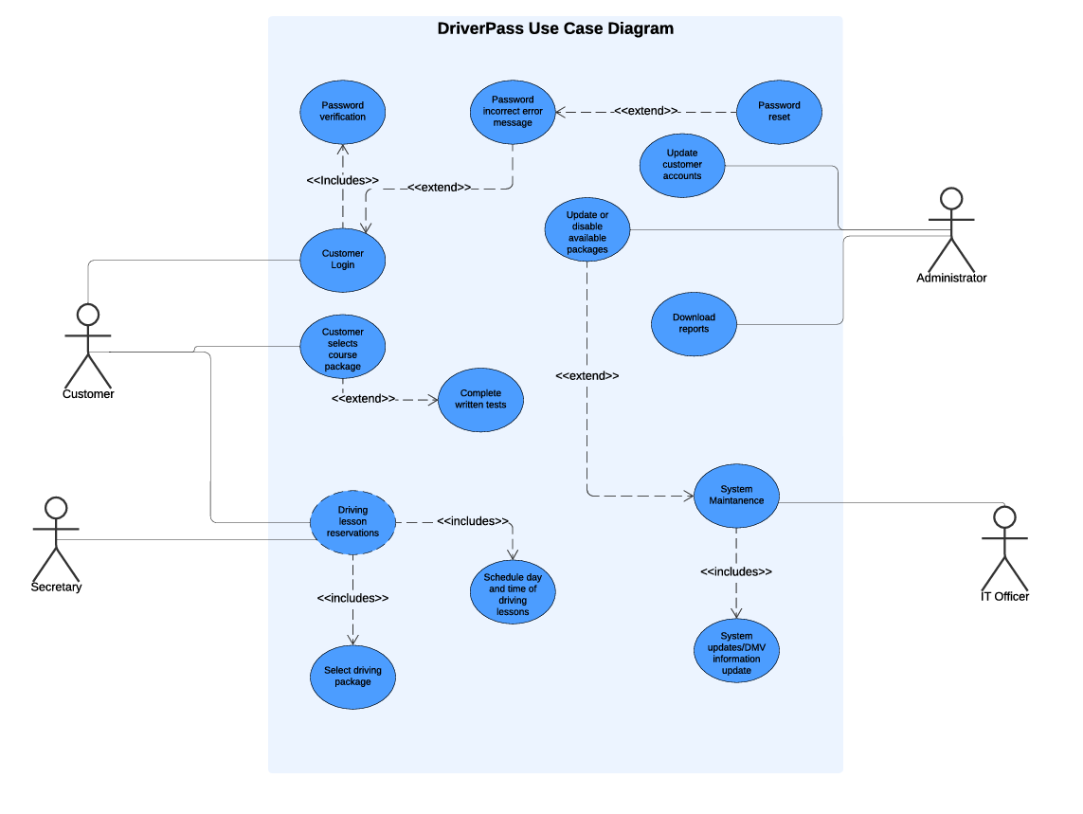
Use Case Diagram
[
Notes:
This is a simple outline of the requirements from DriverPass. Starting with the customer, we see that they have the ability to login, change their password, select a package, complete written exams, and schedule days and times for driving lessons. The secretary is available to help the customer select a package and update their reservations for driving lessons. The administrator is able to help the customer update their information, update available packages, and download reports. The IT officer helps with system maintenance and update system information to align with the DMV.

Slide 4
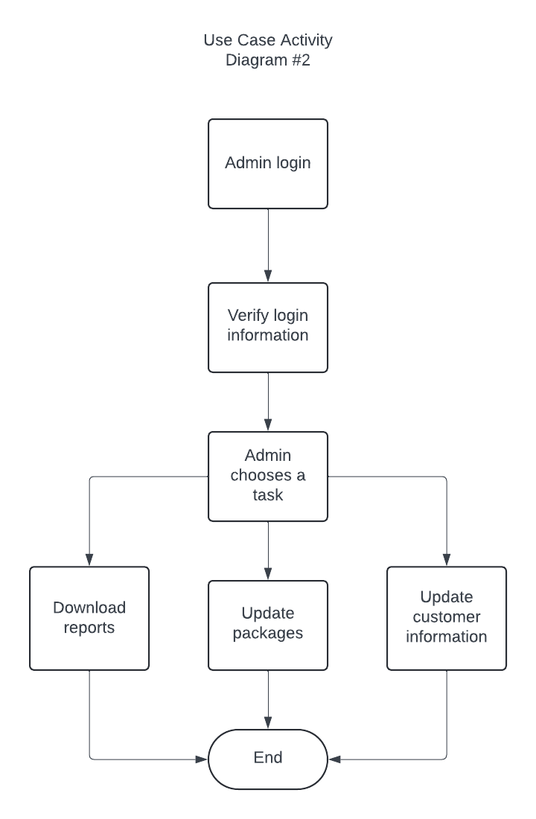
Activity Diagram
Notes:
In this diagram we see a view from the administrator and what they can choose to do. We start with the admin logging in and verifying their login information. Then the admin chooses what they would like to do. They have the option to download reports, update packages, or update customer information. Once they are done with their task, we come to the end of the diagram.

Slide 5
Security
Passwords will be unique to each person, case sensitive, and must include a special character.
Two step verification options.
System lock and alert after 5 failed login attempts.
Notes:
Security is the main concern for an online service provider. Passwords are case sensitive and must include a special character. This ensures a unique password for each person who connects to the system, keeping everyone safe. Two step verification is an added layer of security where there would be an additional email, text, or authenticator app a person would need to be able to sign in to the system. Locking the system and creating an alert after 5 failed login attempts helps ensure that an unauthorized user doesn’t gain access to the system.

Slide 6
System Limitations
Budget
Time
Resources
New requirements
Notes:
System limitations must be considered for this project. The budget for the project was undefined, so it is possible that the budget may not be enough to cover everything in the design. The time allotted for the project was also undefined, so some things may have to be left out due to time constraints. The resources available are currently unknown. An example here would be if there are enough resources, then the team may be larger and that would allow time constraints to be met. New requirements could be added once the project starts, and this can strain the time and budget for the project.

